Slide 1
Hospital Management System
SQL Project
Riya Kumari

Slide 2
Introduction:
The Hospital Management System SQL project is designed to manage and analyze hospital operations using a relational database. This system stores and organizes data related to patients, doctors, appointments, treatments, billing, and payments. Using SQL queries, the project helps convert raw hospital data into meaningful insights that support better decision-making, operational efficiency, and improved patient care.

Slide 3
Objectives:
To design a structured hospital database using SQL
To store patient, doctor, and appointment records efficiently
To track treatments, billing, and payment details
To perform data analysis using SQL queries
To generate insights for hospital management and planning
To improve accuracy, transparency, and data consistency

Slide 4
SQL Queries:
Create a Hospital Database.
Query:
CREATE DATABASE hospital_db;
USE hospital_db;
Insight: A separate database ensures organized storage and easy management of hospital data.

Slide 5
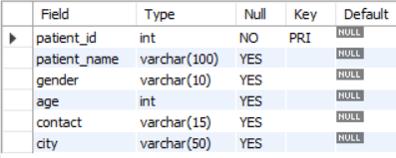
Create Patients Table:
Query:
CREATE TABLE Patients (
patient_id INT PRIMARY KEY,
patient_name VARCHAR(100),
gender VARCHAR(10),
age INT,
contact VARCHAR(15),
city VARCHAR(50));
Insight: This table stores complete patient information such as name, gender, age, contact, and city. It acts as the core entity of the hospital database and helps in tracking patient demographics and visit history.

Slide 6
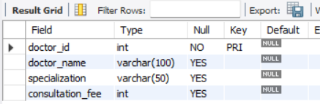
Create Doctors Table:
Query:
CREATE TABLE Doctors (
doctor_id INT PRIMARY KEY,
doctor_name VARCHAR(100),
specialization VARCHAR(50),
consultation_fee INT);
Insight: This table maintains doctor details including specialization and consultation fees. It helps in managing doctor availability, department demand, and revenue analysis.

Slide 7
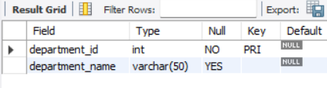
Create Departments Table:
Query:
CREATE TABLE Departments (
department_id INT PRIMARY KEY,
department_name VARCHAR(50));
Insight: This table organizes hospital services into departments. It supports better resource planning and department-wise performance analysis.

Slide 8
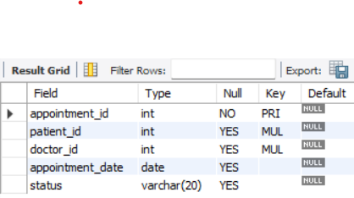
Create Appointments Table:
Query:
CREATE TABLE Appointments (
appointment_id INT PRIMARY KEY,
patient_id INT, doctor_id INT,
appointment_date DATE,
status VARCHAR(20),
FOREIGN KEY (patient_id) REFERENCES Patients(patient_id),
FOREIGN KEY (doctor_id) REFERENCES Doctors(doctor_id));
Insight: This table links patients with doctors and records appointment dates and status. It helps monitor doctor workload, patient flow, and pending or completed consultations.

Slide 9
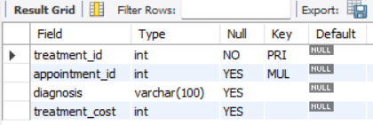
Create Treatments Table:
Query:
CREATE TABLE Treatments (
treatment_id INT PRIMARY KEY,
appointment_id INT,
diagnosis VARCHAR(100),
treatment_cost INT,
FOREIGN KEY (appointment_id) REFERENCES Appointments(appointment_id));
Insight: This table stores diagnosis and treatment cost details for completed appointments. It helps analyze common medical conditions and average treatment expenses.

Slide 10
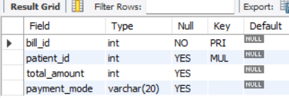
Create Bills Table:
Query:
CREATE TABLE Bills (
bill_id INT PRIMARY KEY,
patient_id INT,
total_amount INT,
payment_mode VARCHAR(20),
FOREIGN KEY (patient_id) REFERENCES Patients(patient_id));
Insight: This table records billing details for patients after treatment. It supports financial tracking, revenue calculation, and payment mode analysis.

Slide 11
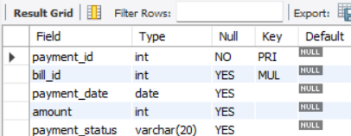
Create Table Payments:
Query:
CREATE TABLE Payments (
payment_id INT PRIMARY KEY,
bill_id INT,
payment_date DATE,
amount INT,
payment_status VARCHAR(20),
FOREIGN KEY (bill_id) REFERENCES Bills(bill_id));
Insight: This table captures payment transactions related to hospital bills. It ensures payment traceability and helps analyze revenue flow and payment status.

Slide 12
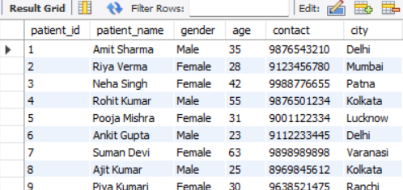
Insert Into Patients:
Query:
INSERT INTO Patients VALUES
(1,'Amit Sharma','Male',35,'9876543210','Delhi'),
(2,'Riya Verma','Female',28,'9123456780','Mumbai'),
(3,'Neha Singh','Female',42,'9988776655','Patna'),
(4,'Rohit Kumar','Male',55,'9876501234','Kolkata'),
(5,'Pooja Mishra','Female',31,'9001122334','Lucknow'),
(6,'Ankit Gupta','Male',23,'9112233445','Delhi'),
Insight: This query populates the database with patient demographic data required for identification and analysis.

Slide 13
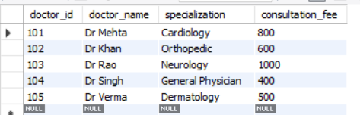
Insert into Doctors:
Query:
INSERT INTO Doctors VALUES(
101,'Dr Mehta','Cardiology',800),
(102,'Dr Khan','Orthopedic',600),
(103,'Dr Rao','Neurology',1000),
(104,'Dr Singh','General Physician',400),
(105,'Dr Verma','Dermatology',500);
SELECT * FROM Doctors;
Insight: This query stores doctor details, enabling specialization-wise and revenue-based analysis.

Slide 14
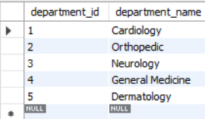
Insert into Departments:
Query:
INSERT INTO Departments VALUES
(1,'Cardiology'),
(2,'Orthopedic'),
(3,'Neurology'),
(4,'General Medicine'),
(5,'Dermatology');
SELECT * FROM Departments;
Insight: This query defines hospital departments to organize services and support department-level reporting.

Slide 15
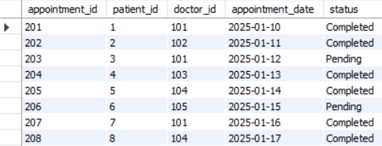
Insert into Appointments:
Query:
INSERT INTO Appointments VALUES
(201,1,101,'2025-01-10','Completed'),
(202,2,102,'2025-01-11','Completed'),
(203,3,101,'2025-01-12','Pending'),
(204,4,103,'2025-01-13','Completed'),
(205,5,104,'2025-01-14','Completed'),
(206,6,105,'2025-01-15','Pending'),
(207,7,101,'2025-01-16','Completed'),
(208,8,104,'2025-01-17','Completed'),
Insight: This query records patient–doctor interactions and helps track appointment status and workload.

Slide 16
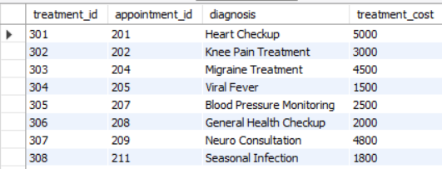
Insert into Treatments:
Query:
INSERT INTO Treatments VALUES
(301,201,'Heart Checkup',5000),
(302,202,'Knee Pain Treatment',3000),
(303,204,'Migraine Treatment',4500),
(304,205,'Viral Fever',1500),
(305,207,'Blood Pressure Monitoring',2500),
(306,208,'General Health Checkup',2000),
(307,209,'Neuro Consultation',4800),
(308,211,'Seasonal Infection',1800),
(309,213,'Joint Pain Treatment',3200);
SELECT * FROM Treatments;
Insight: This query stores treatment and diagnosis information for completed appointments to analyze medical costs and care patterns.

Slide 17
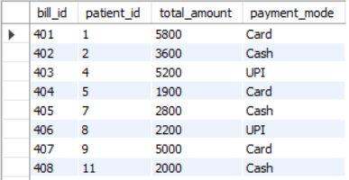
Insert into Bills:
Query:
INSERT INTO Bills VALUES
(401,1,5800,'Card'),
(402,2,3600,'Cash'),
(403,4,5200,'UPI'),
(404,5,1900,'Card'),
(405,7,2800,'Cash'),
(406,8,2200,'UPI'),
(407,9,5000,'Card'),
(408,11,2000,'Cash'),
(409,13,3500,'UPI');
SELECT * FROM Bills;
Insight: This query records billing information for treated patients to support revenue calculation and financial reporting.

Slide 18
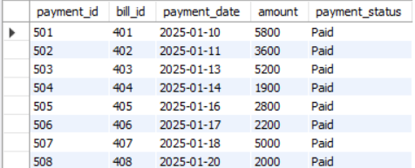
Insert into Payments:
Query:
INSERT INTO Payments VALUES
(501,401,'2025-01-10',5800,'Paid'),
(502,402,'2025-01-11',3600,'Paid'),
(503,403,'2025-01-13',5200,'Paid'),
(504,404,'2025-01-14',1900,'Paid'),
(505,405,'2025-01-16',2800,'Paid'),
(506,406,'2025-01-17',2200,'Paid'),
(507,407,'2025-01-18',5000,'Paid'),
(508,408,'2025-01-20',2000,'Paid'),
(509,409,'2025-01-22',3500,'Paid');
SELECT * FROM Payments;
Insight: This query logs payment transactions, ensuring accurate tracking of hospital income.

Slide 19
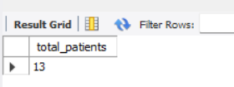
Q1. Total number of patients
Query:
SELECT COUNT(*) AS total_patients
FROM Patients;
Insight: Shows overall hospital reach. A higher count indicates strong patient inflow.

Slide 20
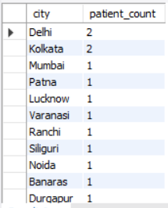
Q2. Patients distribution by city
Query:
SELECT city, COUNT(*) AS patient_count
FROM Patients
GROUP BY city
ORDER BY patient_count DESC;
Insight: Cities with higher patients are key service areas. Marketing and outreach can focus here.

Slide 21
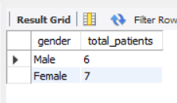
Q3. Gender-wise patient analysis
Query:
SELECT gender, COUNT(*) AS total_patients
FROM Patients
GROUP BY gender;
Insight: Helps understand gender ratio and plan gender-specific health programs.

Slide 22
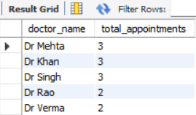
Q4. Doctor-wise appointment count
Query:
SELECT d.doctor_name,
COUNT(a.appointment_id) AS total_appointments
FROM Doctors d
JOIN Appointments a ON d.doctor_id = a.doctor_id
GROUP BY d.doctor_name
ORDER BY total_appointments DESC;
Insight: Doctors with higher appointments have greater workload and may need support.

Slide 23
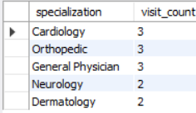
Q5. Specialization-wise demand
Query:
SELECT d.specialization,
COUNT(a.appointment_id) AS visit_count
FROM Doctors d
JOIN Appointments a ON d.doctor_id = a.doctor_id
GROUP BY d.specialization
ORDER BY visit_count DESC;
Insight: High-demand departments may require more doctors or extended hours.

Slide 24
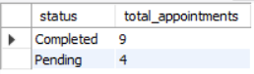
Q6. Completed vs pending appointments
Query:
SELECT status, COUNT(*) AS total_appointments
FROM Appointments
GROUP BY status;
Insight: A high number of pending appointments indicates operational delays.

Slide 25
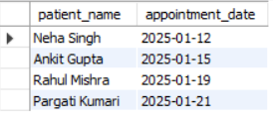
Q7. Patients with pending appointments
Query:
SELECT p.patient_name, a.appointment_date
FROM Patients p
JOIN Appointments a ON p.patient_id = a.patient_id
WHERE a.status = 'Pending';
Insight: These patients need follow-up reminders to reduce no-shows.

Slide 26

Q8. Average treatment cost
Query:
SELECT ROUND(AVG(treatment_cost),2) AS avg_treatment_cost
FROM Treatments;
Insight: Helps hospital review pricing and affordability.

Slide 27

Q9. Total revenue generated
Query:
SELECT SUM(amount) AS total_revenue
FROM Payments;
Insight: Indicates overall financial performance of the hospital.

Slide 28
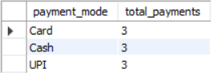
Q10. Payment mode analysis
Query:
SELECT payment_mode, COUNT(*) AS total_payments
FROM Bills
GROUP BY payment_mode;
Insight: Digital payments dominate. Cashless systems should be promoted further.

Slide 29
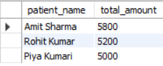
Q11. High-value patients (bill > 4000)
Query:
SELECT p.patient_name, b.total_amount
FROM Patients p
JOIN Bills b ON p.patient_id = b.patient_id
WHERE b.total_amount > 4000;
Insight: High-value patients can be offered loyalty or premium care plans.

Slide 30
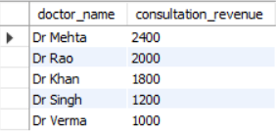
Q12. Doctor-wise consultation revenue
Query:
SELECT d.doctor_name,
COUNT(a.appointment_id) * d.consultation_fee AS consultation_revenue
FROM Doctors d
JOIN Appointments a ON d.doctor_id = a.doctor_id
GROUP BY d.doctor_name, d.consultation_fee
ORDER BY consultation_revenue DESC;
Insight: Identifies top revenue-generating doctors.

Slide 31
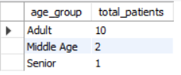
Q13. Patient age group analysis
Query:
SELECT CASE
WHEN age < 18 THEN 'Child'
WHEN age BETWEEN 18 AND 40 THEN 'Adult‘
WHEN age BETWEEN 41 AND 60 THEN 'Middle Age'
ELSE 'Senior‘ END AS age_group,
COUNT(*) AS total_patients
FROM Patients
GROUP BY age_group;
Insight: Adult patients form the majority. Preventive care programs can target this group.

Slide 32
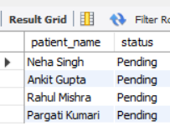
Q14. Patients without treatments
Query:
SELECT p.patient_name, a.status
FROM Patients p
JOIN Appointments a ON p.patient_id = a.patient_id
LEFT JOIN Treatments t ON a.appointment_id = t.appointment_id
WHERE t.treatment_id IS NULL;
Insight: Highlights incomplete care cases that need attention.

Slide 33
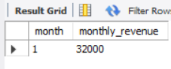
Q15. Monthly revenue trend
Query:
SELECT MONTH(payment_date) AS month,
SUM(amount) AS monthly_revenue
FROM Payments
GROUP BY MONTH(payment_date)
ORDER BY month;
Insight: Useful for tracking growth and seasonal trends.

Slide 34
Overall Insights:
Cardiology and Orthopedic departments show higher patient demand
Most payments are done through digital modes like UPI and Card
Adult age group (18–40) forms the majority of patients
Some appointments remain pending, indicating follow-up gaps
Revenue generation is stable but can be improved with better service optimization

Slide 35
Recommendations:
Increase staff or slots in high-demand departments
Introduce automated reminders for pending appointments
Promote cashless and digital payment systems
Offer health packages for frequent or high-value patients
Use dashboards (Power BI) for real-time monitoring

Slide 36
Final Evaluation:
The Hospital Management System SQL project successfully demonstrates the use of relational databases and SQL queries in a real-world scenario.
It shows how structured data storage and analysis can improve hospital efficiency, patient management, and financial tracking.T
his project builds a strong foundation in database design, SQL querying, and data-driven decision-making, making it suitable for academic submission and entry-level data or database roles.

Slide 37
Thankyou!

